Slide 1
ADVERSE DRUG REACTION
BY
DR.G.AARTHIPRIYANKA
POST GRADUATE
DEPARTMENT OF PHARMACOLOGY

Slide 2
DEFINITION
Any noxious, unintended, undesirable effect of a drug which occurs at a dose used in humans for prophylaxis or modification of physiological functions.

Slide 3
RAWLINS & THOMPSON-1985 CLASSIFICATION
TYPE A: Augmented effects – dose dependent & predictable
TYPE B: Bizarre effects – dose independent & unpredictable
TYPE C: Chronic effects
TYPE D: Delayed effects
TYPE E: End of treatment effects
TYPE F: Failure

Slide 4
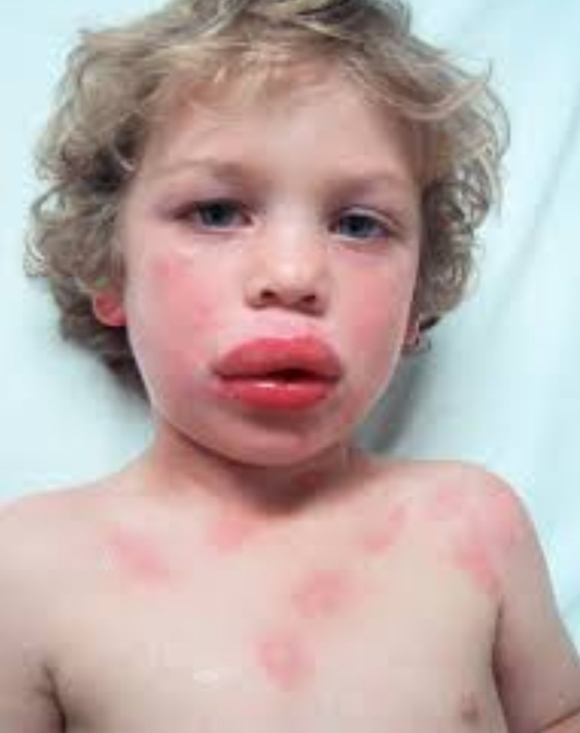

Slide 5
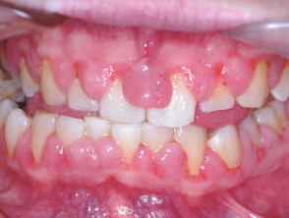

Slide 6
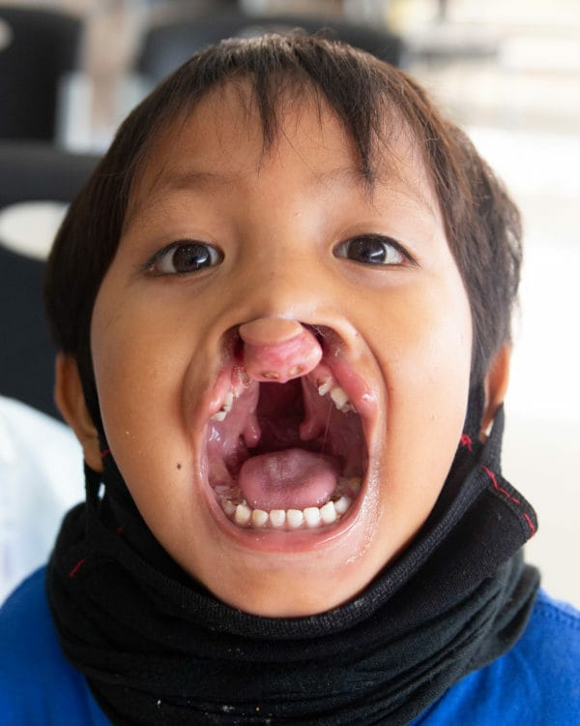
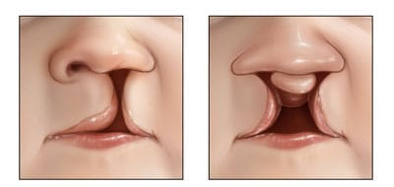

Slide 7
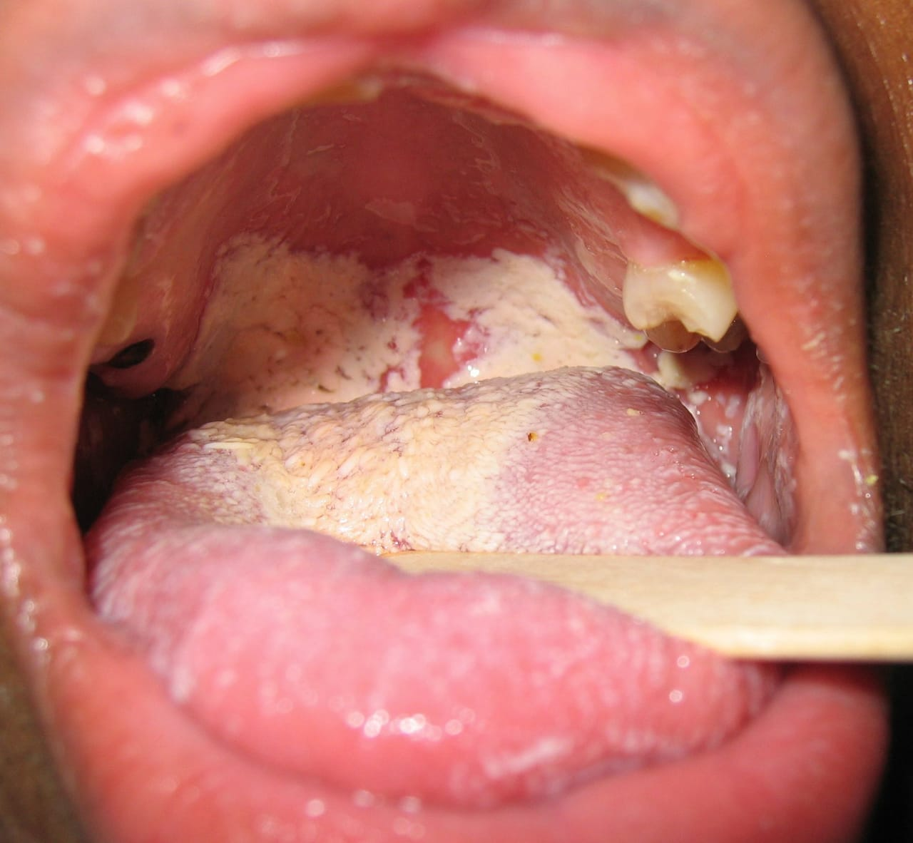

Slide 8
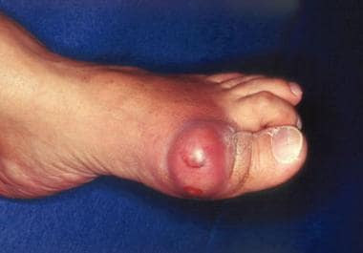

Slide 9
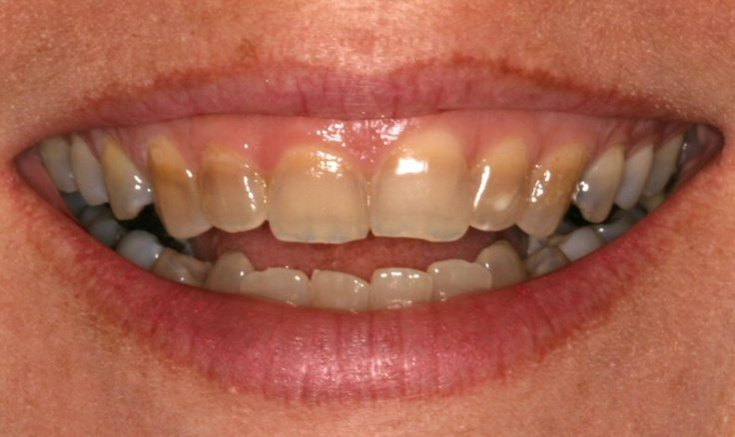

Slide 10
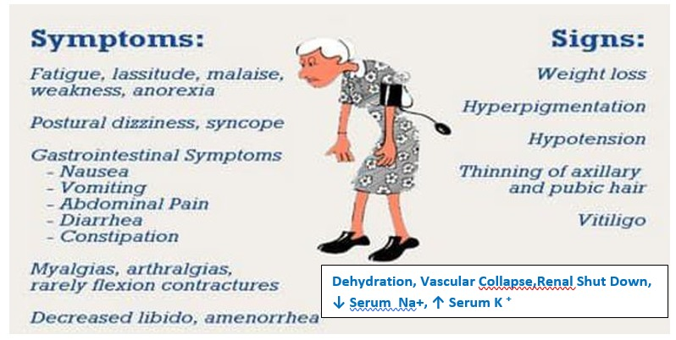

Slide 11
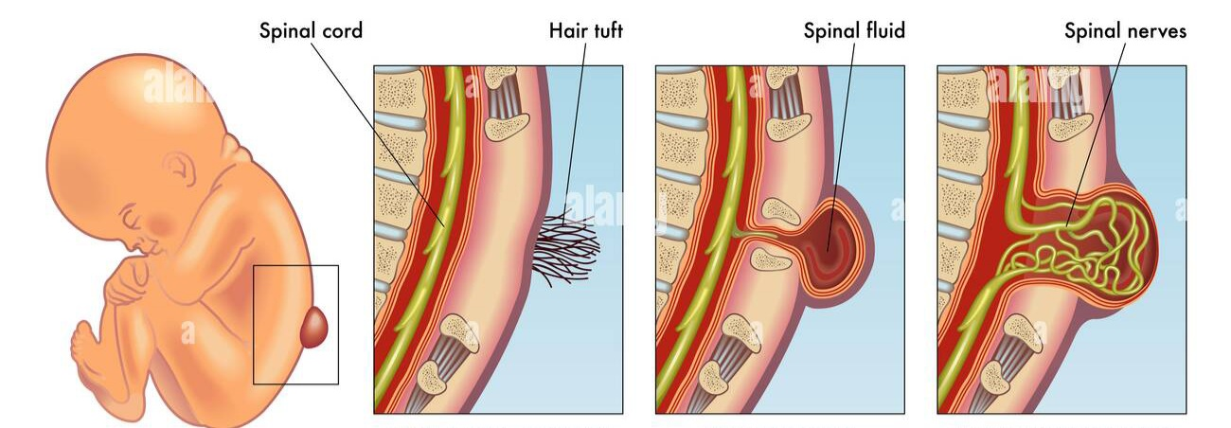

Slide 12
PH 1.7 DEFINE, IDENTIFY & DESCRIBE THE MANAGEMENT OF ADVERSE DRUG REACTIONS (ADR)
CHART –1

Slide 13
CHART –1 ( Spina Bifida)
a) Identify & Describe The ADR:
Spina Bifida.
Type—D ADR . This Is Neural Tube Defect Due To Drug Teratogenicity.
b) Mention The Drug responsible
Sodium Valproate
C) What Is The Line Of Management?
Avoid Sodium Valproate In first Trimester. If Valproate Is To Be Continued In 2nd & 3rd Trimester, Supplement With Folic Acid & Vit K.

Slide 14
CHART – 2

Slide 15
CHART –2 ( Gum Hyperplasia )
Identify & Describe The ADR:
Gum Hyperplasia..
Type –A ADR . Undesired Side Effects Occurring With Therapeutic Dose. It Is Due To Over Growth Of Gingival Collagen Fibers Occurring In 20% Of All Patients Receiving Chronic Therapy With Phenytoin.
b) Mention The Drug Responsible:
Phenytoin Sodium.
c) How Do You Treat?
Good Oral Hygiene With Periodontal Procedures Like Scaling & Root Planning.
Folic Acid Supplementation.

Slide 16
CHART –3

Slide 17
CHART –3 ( Anaphylaxis )
Identify & Describe The ADR:
Anaphylaxis.
Type—B ADR. Bizarre , Unpredictable Type & Not Related To Pharmacological action.
b) Mention The Drugs Responsible :
Beta Lactam Antibiotics ---Penicillin G, Cephalosporins
Iodine Containing Agents---Radiocontrast Dye, Povidone Iodine
Sulphur Containing Agents--- Sulphonamides
Fibrinolytics ---Streptokinase.

Slide 18
C) What Is The Line Of Management?
Inj. Adrenaline – 0.3 To 0.5 ml Of 1in1000 By IM( Or O.5 To 1 ml Of 1 In 10,000) . May Be Repeated Every 10 To 20 min For 3 Doses Until The Patient Improves
Inj. Hydrocortisone –100mg IV every 6 hrs
Inj. Diphenhydramine –50 To 100mg IM . May Be Repeated Every 4 to 6 hrs.
Infuse Normal Saline 1 To 2 L In 30 minutes
Nebulise Salbutamol 2.5 To 5mg + Ipratropium Bromide 0.5 mg in 2.5ml of Normal saline. Repeated Every 4 hrs
Inj. Aminophylline 5mg/kg IV loading Dose Followed By 1mg/kg/hr Infusion As Maintenance.

Slide 19
CHART—4 The Picture Is Oral Cavity Of A 60 Year Male Patient , Known Diabetic For 10 years, has Been Undergoing treatment With Inhalant Ciclesonide For Bronchial Asthma For The Past 2 years.

Slide 20
CHART—4 ( Oral Thrush )
Identify & Describe The ADR :
Oral Thrush.
Type—C ADR. Due To Immunosuppression Due To Prolonged Use Of Inhalant Corticosteroids .
Mention The Drugs Responsible :
Inhalant Corticosteroids --- Beclomethasone, Ciclesonide, Budesonide etc
Immunosuppressants ----Cyclosporine, Tacrolimus, Methotrexate, Cyclophosphamide.
How Do You Treat ?
Topical Application Of Clotrimazole, Nystatin
Precaution : Gargle/Rinse The Mouth After Using Inhalant Corticosteroids.
Patient’s blood Sugar Should be Monitored Periodically

Slide 21
CHART-5

Slide 22
CHART---5 ( Gouty Tophus)
Identify & Describe The ADR :
Gouty Tophus.
Type –A ADR. This Is A Undesired Side Effect Occurring Due To Drugs Which cause Hyperuricemia & Precipitates In patients With Gout.
b) Mention The Drugs Which can Precipitate:
Thiazides, Furosemide, Pyrazinamide, Ethambutol, Anticancer Drugs Etc.
c) How Do You Treat?
Avoid The Drugs Which Cause Hyperuricemia In Gout Patients.
Continue The Other Drugs For Gout.

Slide 23
CHART—6

Slide 24
CHART—6 ( Yellowish Brown Discolouration Of Teeth)
Identify & Describe The ADR :
Yellowish Brown Discoloration Of Teeth.
Type A – ADR. Undesired Side Effect Due To Tetracycline
b) Explain How Tetracycline Produces The Above ADR?
Tetracyclines Chelate Calcium From Bone &Teeth In Children Less Than 7 Years ( When Teeth Are Being Calcified). Calcium—Tetracycline Chelate Gets Deposited In Developing Teeth Causing Brown Discoloration, ill—formed Teeth Which Are More Susceptible To Caries. Given During Late Pregnancy, tetracyclines In Addition To Causing Brownish Discoloration Of Teeth, It Can Cause Temporary Suppression Of Bone Growth In Children.
c) What Is The Line Of Management?
Avoid Tetracyclines In Pregnancy & In Children Less Than 7 Years.

Slide 25
CHART –7

Slide 26
CHART –7 ( Cleft Lip & Cleft Palate)
Identify & Describe The ADR:
Cleft Lip & Cleft Palate.
Type—D ADR. This Is Due To Drug Teratogenicity.
b) Mention The Drugs Responsible:
Phenytoin Sodium & Methotrexate.
c) How Do You Manage?
Above Drugs Should Be Avoided During Pregnancy

Slide 27
CHART—8 A 35 Year Old Female Of Inflammatory Bowel Disease Was On Prednisolone 40 mg/Day & Mesalazine 800mg bd For 4 Weeks. She Stopped taking Prednisolone Abruptly Without Doctor’s Advice & She Developed Below Signs & Symptoms.

Slide 28
CHART—8 ( Acute Adrenal Insufficiency)
Identify & Describe The ADR :
Acute Adrenal Insufficiency.
Type---E ADR. Due To Abrupt Cessation Of Corticosteroid. Exogenous Steroid For Longer Than
2 To 3 Weeks Suppresses Hypothalamo—Pituitary—Adrenal Axis. Hence Stoppage Of Exogenous
Steroids Precipitates Acute Adrenal Insufficiency.
b) Mention Other Drugs Which Should Not Be Withdrawn/Stopped Abruptly:
Beta -- blockers, Clonidine, Anti-epileptic Drugs, Alcohol, Benzodiazepines, Opioids, CNS Stimulants Like Cocaine, Amphetamine, Methamphetamine.
c) What Is The Line Of Management?
Acute Adrenal Insufficiency Is Treated By IV Hydrocortisone & IV Isotonic Saline In Glucose Solution. Any Patient Who Has Received Steroids For > 2 To 3 Weeks Should Be Put On A Scheme Of Gradual Withdrawal.

